Slide 1

Receivables Finance
a flexible tool to manage Working Capital
Amador Malnero April 2017
ING Wholesale Banking

Slide 2
Contents
Introduction
Global and sectorial trends in working capital needs
Changing environment and impact on Treasury
Overview of trade receivable financing options
Case study

Slide 3
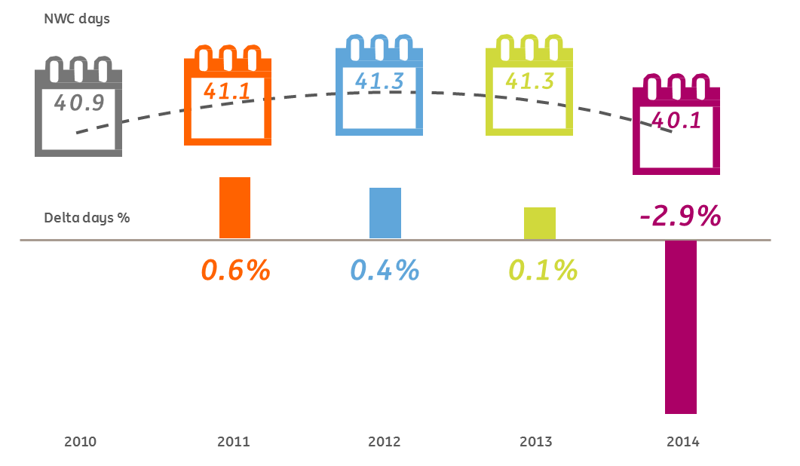
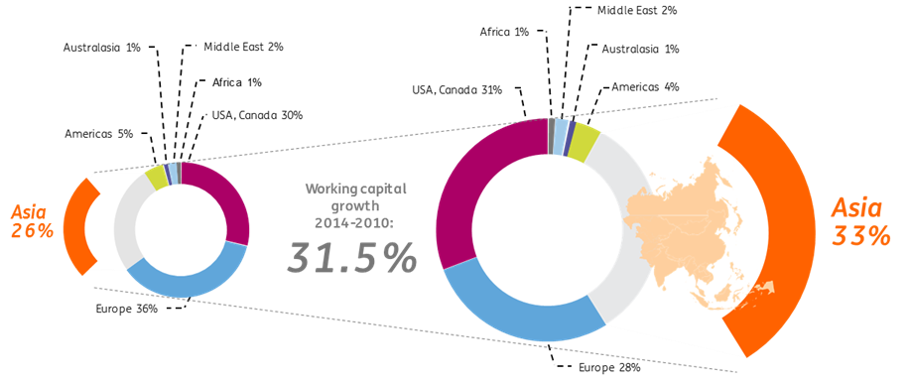
Trends in Working Capital Needs*
First since 2010, working capital needs have improved significantly on a global scale. 2014 saw a compelling contraction in working capital by almost 3% bringing it back to pre-crisis levels.
However, working capital consumption clings to the specific sector with “pharmaceuticals”, “metals”, “engineering & construction” and “industrial manufacturing” as frontrunners.
Only a few of the industries ware able to manage a decrease in working capital since 2010.
Off-shoring towards the east has a negative impact on working capital levels over there.
Metals
Communications
Energy, utilities & mining
Healthcare
Forest, paper & packaging
Pharmaceuticals
& life sciences
‑0.4%
Retail & consumer
‑0.2%
0.2%
Aerospace & defence
0.6%
Transportation & logistics
0.6%
Entertainment & media
1.0%
Automotive
1.1%
Hospitality & leisure
1.2%
Industrial manufacturing
1.3%
Chemicals
1.5%
Technology
4.5%
Engineering & construction
‑3.1%
‑2.1%
‑1.7%
‑0.7%
‑0.7%
92
71
71
69
65
64
64
58
48
47
39
36
29
29
27
6
Improvers
Non-improvers
Pharmaceuticals
& life sciences
Metals
Engineering
& construction
Industrial manufacotring
Technology
Forest, paper & packaging
Chemicals
Healthcare
Retail & consumer
Automotive
Aerospace, defence & security
Entertainment & media
Transportation & logistics
Communications
Energy, utilities & mining
Hospitality & leisure
* Source: 2015 Annual Global Working Capital Survey by PwC

Slide 4
DSO, DIO, DPO by sector*
* Source: 2015 Annual Global Working Capital Survey by PwC

Slide 5
DSO, DIO, DPO by macro region*
* Source: 2015 Annual Global Working Capital Survey by PwC

Slide 6
“Global stabilisation hides the underlying different regional trends”
DSO, DIO, DPO over time*
“W/C improvement mainly driven by reductions in receivables fuelled by the 2013 EU directive on late payment, securitisation and outsourcing”
* Source: 2015 Annual Global Working Capital Survey by PwC

Slide 7

This improvement has contributed to a significant jump of 11,3% in the cash‑on‑hand balances, which grew to EUR 3.17 trillion in 2014...*
“cash grows at a faster pace than reveneues”
3.17
11.3%
2.77
2.85
2.44
2.60
6.8%
6.3%
“… as well as soared profitability & cash flow generation, dropped interest expenses and lesser CAPEX”
2.8%
2010
2011
2012
2013
2014
Cash-on-hand (EUR trillion)
Year-on-year change
* Source: 2015 Annual Global Working Capital Survey by PwC

Slide 8


The role of Treasury is changing
Treasury role is influenced by several factors… …and is becoming more strategic
1
Business profile
→international/domestic, public/private ownership
Size
→large companies, more centralised staff
Objectives
2
Influencing business strategy
Maximising
shareholder value
3
Industry
→how is the competition structured
Optimised
Cash & Risk
Business advisor
4
Type of cash flows
→retail cash vs electronic flow
Efficiency
Working Capital
management
5
Business culture
→entrepreneurs prefer decentralised approach
Efficient and
effective processes
6
Technology
→facilitating complex implementation / systems
Controls and
minimising costs
Transactional and risk focus treasury
Visibility &
Control
7
Need for control
→regulatory emphasis and need for information
Operational
Strategic
Role
8
Experience Treasurer
→style, approach and background

Slide 9







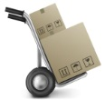











Typical treasury and working capital improvement areas
Internal optimisations
Value Chain
External solutions
Rationalise purchasing
Suppliers
Supply Chain Finance
A/P process improvement
Raw material
Payables
Cards solutions
L/C’s & guarantees
Inventory management
Work in progress
Cash
Payment & cash Management
Incentives alignment
Finished goods
Receivables
Risk management
A/R process improvement
Liquidity management
Centralise treasury
Customers
$
£
€
¥
Receivable-based finance
Physical supply chain
Financial supply chain

Slide 10



Internal optimization usually is a first step to improve W/C performance
Internal optimisations
Value Chain
External solutions
Centralised receivables collection
Centralised payments processing
Increased visibility and monitoring
  Centralised purchasing with consolidated view on suppliers
  Overall harmonisation of terms between different buyer and supplier entities
  Payment term extension
  Provide procurement with W/C KPIs
Rationalise purchasing
Suppliers
Supply Chain Finance
$
£
  Efficient invoicing
  Implementation of direct debits
  Collection and late payment follow up procedure (credit mgnt.)
  Monitor aging and establish clear dispute management
Cards solutions
A/P process improvement
Raw material
Payables
€
¥
Rationalise purchasing
Centralise treasury
  Establish STP via ERP
  Review payment run frequency (e.g. payments once in two weeks)
  Avoid late payment penalties by paying on due date
  Avoid early payments
L/C’s & guarantees
Inventory management
Work in progress
Cash
A/R process improvement
A/P process improvement
Payment & cash Management
Incentives alignment
  Define and align KPIs and incentives (between procurement, finance and treasury) to support W/C performance
  Monitor early payment and volume discounts
  Stock keeping unit management
  Regular sales and operations planning
  Optimal order size and centralised warehouses
  Supplier location
Finished goods
Receivables
Risk management
A/R process improvement
Inventory management
Incentives alignment
Liquidity management
Centralise treasury
Customers
$
£
€
¥
Best practice treasury can no longer take place in isolation
Receivable-based finance
Physical supply chain
Financial supply chain

Slide 11
Market facts & figures
Europe
International: 20%¹
€ 1,487 billion (+ 9,8%)
Domestic: 80%¹
Americas
€ 196 billion
(+ 2%)
Global Factoring market
€2,311 billion¹
Africa
€ 25 billion
(+ 8,6 %)
Securitization
Asia
€ 603 billion
(- 5,6 %)
~ € 230 bn²
2 Finacity, “Funding through the Use of Trade Receivable Securitizations”, 2008
1 FCI, “Global factoring volume reaches € 2,311 billion euros in 2014”, 2015
* Global Factoring market

Slide 12
Receivables based finance
What is receivable-based finance?
Receivable-based finance facilitates a company in optimizing Working Capital and represents an attractive alternative funding source through the financing of trade receivables. Depending on the number of debtors, size of the receivables and granularity of the portfolio, various solutions can be offered: Corporate Factoring, International Corporate Receivables Financing (ICRF) and Trade Receivables Purchasing program (TRPP).
Schematic overview
Receivable-based finance benefits
  Each solution can be tailored to the specific needs of a the particular company
  Diversification of funding sources; scalable to finance trading growth
  Tailor made and highly flexible (multi-originator, -jurisdiction, -currency)
  Uncommitted or committed; maximum tenor of 3 year
  Off-balance sheet treatment possible
_{A/R}
_{A/R}
_{A/R}
_{A/R}
_{Receivables Pool}
_{A/R}
_{A/R}
_{A/R}
_{A/R}
_{A/R}
_{A/R}
_{A/R}
_{A/R}
Single debtor
Multiple debtors
Portfolio approach
FACTORING
  Flexible Pan-European funding
  Daily funding/settlement
  Intraday consolidated monitoring through our App
  Initiator & market leader of Pan-European syndication
  Silent assignment possible
ICRF
  Line-by-line approach suited for concentrated debtor portfolio
  Flexible structure from single receivable financing to a facility for multiple receivables
  Quick execution process
  Silent assignment possible
TRPP
  Strong balance sheet management tool
  Portfolio approach provides flexibility
  Multiple jurisdictions, originators, and currencies can be brought together under one program
  Granular A/R portfolio
Single invoice / multiple invoices
Non-Granular Portfolio
Granular Portfolio
ICRF/ Factoring
TRPP / securitisation
12

Slide 13

Typical structure
Portfolio of trade receivables
Receivables Purchase Agreement
Servicing Agreement
Obligor 1
Obligor 2
Servicing
Originator
Purchase Price
Purchaser
Obligor 3
Receivables
True sale
of receivables
Obligor 4
Obligor …
Collections
Collections
Obligor N
Credit Insurance
Main setup
  ING enters into a receivables purchase agreement for the purchase of receivables against pre-selected criteria
  Receivables, which meet the eligibility criteria, are sold to ING
  On a periodical basis, the evolution of the portfolio will be assessed and a netted settlement takes place
  Prior to certain event, the obligors are not notified of the sale of their receivables to ING allowing them to maintain all commercial relations with its clients
  The seller remains liable for any non-cash reduction in receivables amount and will provide assistance to ING in the recovery process to the extent required
13

Slide 14
Principles
Funding using securitisation techniques
    A granular pool of homogeneous assets (trade receivables) is isolated from the credit risk of selling company and transferred by means of a true sale to ING’s balance sheet.
    The transferred trade receivables then liquidate in the course of time: the structure is continuously refilled with new assets during the programme life.
Principles of the Trade Receivables Purchase Programmes
    Reliance on the performance of the asset portfolio (rather than the credit quality of the originator) for repayment
    Insulation from or mitigation of the exposure to the originator events
    Credit enhancement to optimise funded amount and pricing of the facility
Pricing and Funding
Structures mitigate the traditional credit risk and enhance the transaction rating
    Ring-fencing, true sale of the pool of receivables
    Credit enhancement provided by dynamic reserves in the form of over-collateralisation or by credit insurances
    Structural mechanisms activated by pool performance triggers, rating triggers or financial covenants
Structures set up in accordance with S&P methodology
    Analysis of the pool historical performance and the transaction structural features
    No formal rating required
14

Slide 15
Purchase Price Mechanism: Reserves
    Mitigant against the risk of obligor delinquency and default
    Historic delinquency and write-off performance = best indicator of portfolio credit quality
    Reserve size based on portfolio’s historical
    performance
    Reserve is dynamic and adjusted
    periodically (typically monthly)
    Is partially or totally replaced by an
    insurance policy for the Building
    and Industrial Portfolio
    Mitigant against any non-cash reduction to a receivable balance not due to default or write-off (product returns, cash discounts, pricing disputes, billing errors….)
        Risk linked to the Viohalco and not the portfolio
        Recourse on Viohalco for dilution risk materializes when Viohalco is bankrupt
          Dilution coverage is derived on the basis of historical performance
            Reserve is dynamic and adjusted to reflect actual performance (typically monthly)
Default Reserve
Dilution Reserve
Yield Reserve
Other Reserve
    Covers interest and fees in a
    liquidation phase scenario
          Covering specific risks in the transaction
            Concentration risk
            Set-off risk
          Commingling risk
          Purchased but not funded

Slide 16
Benefits
Funding
Off-balance sheet treatment
Operational Excellence
  Credit enhancement up to AA equivalent allows competitive pricing compared to other medium-term funding alternatives, and increases funding capacity
  Firm 1 to 3 year commitment scalable to finance trading growth
  (Excess) remain available for your treasury between transfer/settlement dates
  Possibility to achieve off-balance sheet treatment (de-recognition under IAS 39 or local GAAP)
    for TRPP programmes with credit insurance
    upon substantial transfer of risks and rewards
  Strong balance sheet management tool
    improved financial ratios thanks to enhanced working capital efficiency
    lower pricing grid thanks to ratios enhancement
    financial covenant management
  Single transaction customised to your specificities and easily adapted at renewal moments
  Multiple jurisdictions, originators and currencies can be brought under one programme
  Portfolio approach provides flexibility in terms of pool composition
  Assignment is typically silent, with no impact on the commercial relationship with the debtors
  Reporting consisting of limited monthly excel files (aggregated information on the portfolio performance)
  One single contact person at ING
Flexibility
A powerful tool for managing working capital needs
16

Slide 17

IFRS vs. USGAAP Off-Balance sheet principles
    The cash flow right of the sold receivables isn’t expired yet + allowed collection of the seller
    Cash flows can be passed through when collection were received without material delay and selling or pledging the assets is no longer allowed.
Pricing and Funding
    A substantial part of the risks (credit, FX and yield risk) and rewards should be transferred
    The asset must be isolated even in case of the seller’s bankruptcy by a true sale
    The purchase should be free the sell or pledge the acquired receivables
    There must be no repurchase agreement of repurchase option
17

Slide 18

Case: Russian steel producer
EUR 40 Million multi-currency (EUR & PLN) trade receivables purchase programme (TRPP)
Latvia & Poland
2015- …
ING’s Role:
Steel Producer
The Client
The Transaction
Sole-arranger &
Sole-lender
EUR 40 Mio
Trade receivables purchase
programme
The Company is one of the largest Russian vertically integrated steel producers measured over its crude steel production and market capitalisation.
The Company is one of the lowest costs producers in the world with unique vertically integrated business structure.
The Company enjoys a favorable geographic location (proximity to both the local markets and the main export routes; the Group's revenue is highly diversified over the world: Russia - 59%, Europe - 21%, N. America - 4% and remaining 16% of sales spread over Asia, S. America and Africa
EUR 40 million multi-currency (EUR and PLN) TRPP for the Company.
the Company has successfully stepped into its first Receivables Securitisation.
the Company’s objectives were to provide working capital optimization via innovative tool “Receivable Securitization”. That is why IFRS treatment of the tool as off-balance transaction was critical for the Company. It allows to diversify the Company’s Free Cash Flow resources with creation of a tool that can grow with the working capital needs of the company.
Work included:
Deal structure and strategy to implied AAA level
ING acted as Sole Arranger and Lender.
ING provided the Company with a detailed explanation on all structural elements.
Very successful collaboration between the central WCS team and the local Moscow Clients and TSS teams.
Lead Arranger and Liquidity Provider
Iron, Steel Mills & Ferroalloy Manufacturing
Key Terms
  Maximum limit amount:
  EUR 40 mln equivalent
  Funded in EUR and PLN
  Commitment:
  Uncommitted
  Originators:
  Based in Latvia & Poland
  Specificity:
  Long structuring and detailed explanatory process.
18

Slide 19

Case: Austrian subsidiary of Russian petrochemicals producer
EUR 60 Million Equivalent multi-currency (EUR & USD) trade receivables purchase programme (TRPP)
Austria
2015- …
ING’s Role:
Petrochemicals Producer
The Client
The Transaction
Sole-arranger &
Sole-lender
EUR 60 Mio
Trade Receivables Purchase Programme
Russia's leading producer of petrochemicals
As of end of year 2016, the Company operated 26 production sites, had over 27,000 employees and served more than 1,400 large customers in the energy, automotive, construction, fast moving consumer goods (FMCG), chemical, and other industries in approximately 70 countries.
ING’s relationship with the Company dates back to 2005 and is one of ING Russia main client.
EUR 60 million multi-currency (EUR and USD) TRPP. The transaction is uncommitted and includes a credit insured portfolio of EUR 60 Mio Equivalent and allows for concentrated exposure against selected names.
Company’s objectives were to reduce working capital through off-balance sheet transaction and to create a tool with a potential of growth according to needs of the company.
Work included:
Deal structure and strategy
Coordination of the entire process
Funding of the transaction through the balance sheet of ING Belgium
ING acted as Sole Arranger and Lender
Detailed explanatory process to the client
Lead Arranger and Liquidity Provider
Petrochemical Manufacturing
Key Terms
  Maximum limit amount:
  EUR 60 mln equivalent
  Funded in EUR and USD
  Commitment:
  Uncommitted
  Originators:
  Austrian subsidiary of Russian leading petrochemicals’ producer
  Specificity:
  Full transaction up to EUR 90 Mln with ICRF
19

